Slide 1


Integrative Project In Industrial Electronics and Computers Engineering
Sensoring System for Superficial Sea Streams
5S – Drifter
Professors: Luis Gonçalves and Sergio Lopes
Student: Vinicius C. A. Carvalho - PG56208

Slide 2
Agenda
Introduction
Project Statement
Project Statement Analysis
Analysis
Requirements
Constraints
State of the Art
System Architecture
Design
Implementation

Slide 3
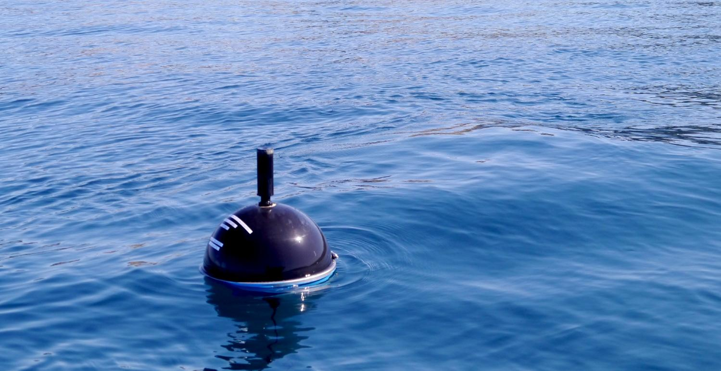
Introduction

Slide 4
Project Statement
20 to 26% of the ocean is mapped (superficial and deeper areas) .
Around 80% of commercial trades are made by the sea.
Risky environment.
IPC as a commercial rout at Portugal scale.

Slide 5
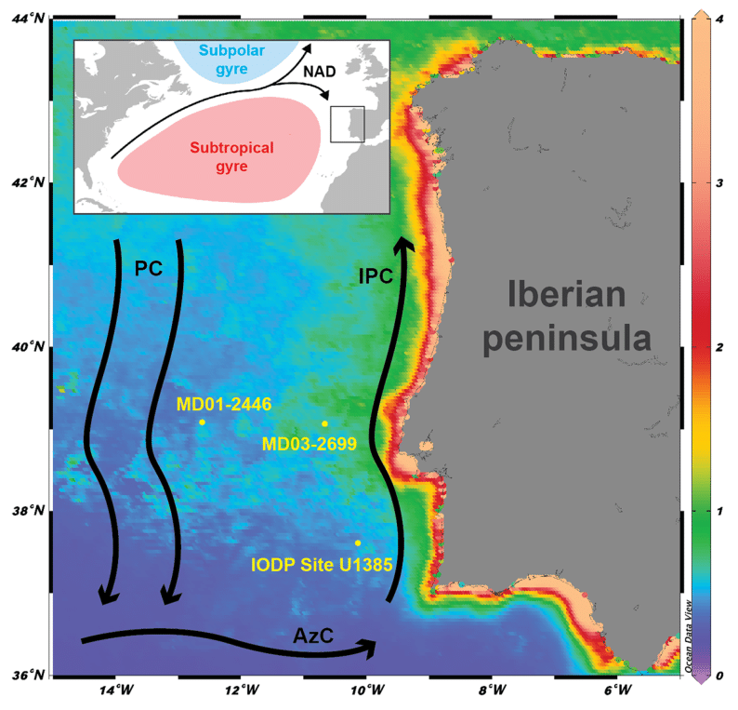
Project Statement
IPC (Iberian Poliward Current)
NAD: North Atlantic Drift
PC: Portugal Current
IPC: Iberian Poleward Current AzC: Azores Current.
This map shows chlorophyll concentration

Slide 6
Project Statement Analysis
Data acquisition
Power Level
Wave Intensity
Position
Temperature
Send Data Wirelessly
Store Data Locally
Autonomy (Low Power)
Resistant and buoyant outer shell

Slide 7
Analysis
Microcontroller
GNSS
Mobile Communication
Power Source
Sensors
IMU
Temperature
Power Source Level

Slide 8
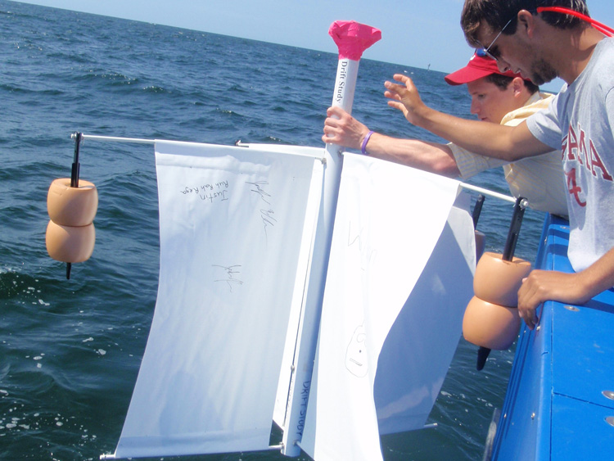

State of Art

Slide 9
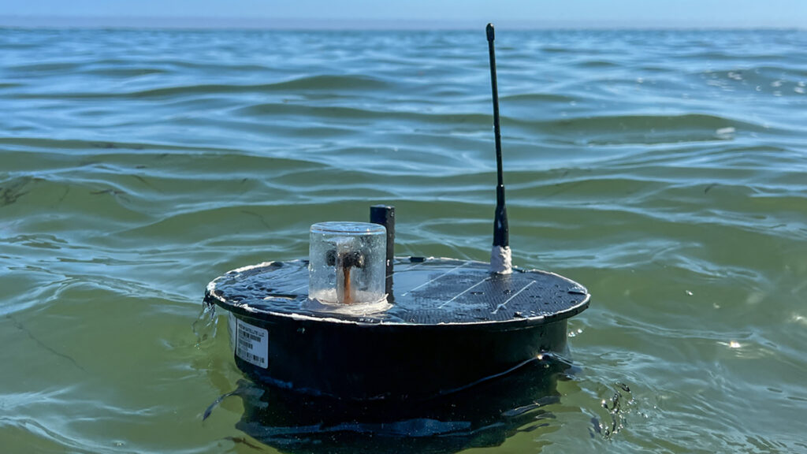


State of Art

Slide 10

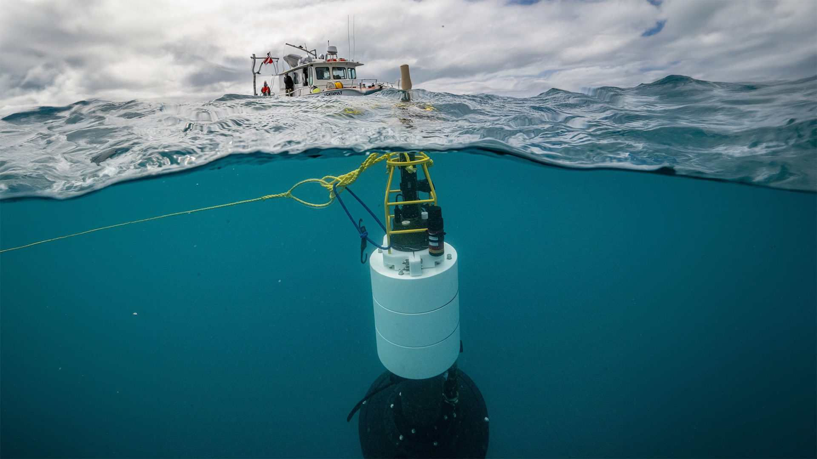
State of Art

Slide 11
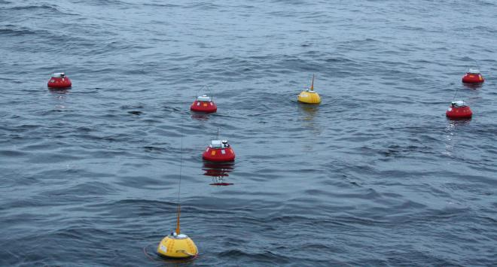

State of Art

Slide 12

State of Art
Next Sea – Next generation monitoring of coastal ecosystems in a scenario of global change
Sonda – Synchronized Atmospheric and Oceanic Data Acquisition

Slide 13
State of Art
Border Control
Climate Modeling
Traffic management
Aquaculture management
Public oceanographic research
Marine spatial planning
Defense and security

Slide 14
Requirements
Search and selection of hardware components
Low Power and Low Cost
Software/Hardware design
Communication within modules and peripherals
PCB design*
Energy Harvesting*
5S outer shell as a 3D design
Product realization
Laboratory Tests
Documentation
* On analysis

Slide 15
Constraints
Be presented for evaluation within deadline
Limited team.
Be validated at the ocean.
Have an autonomy of a month at minimum
Due to the low power consumption and lab availability, an STM32 will be used.

Slide 16
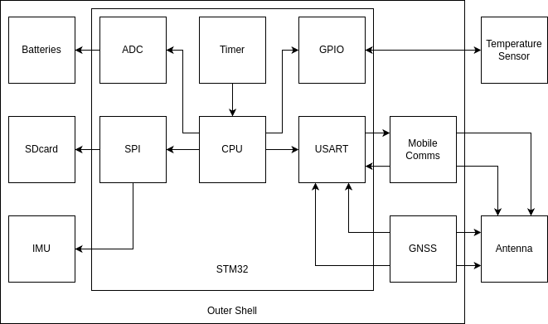
System Architecture

Slide 17
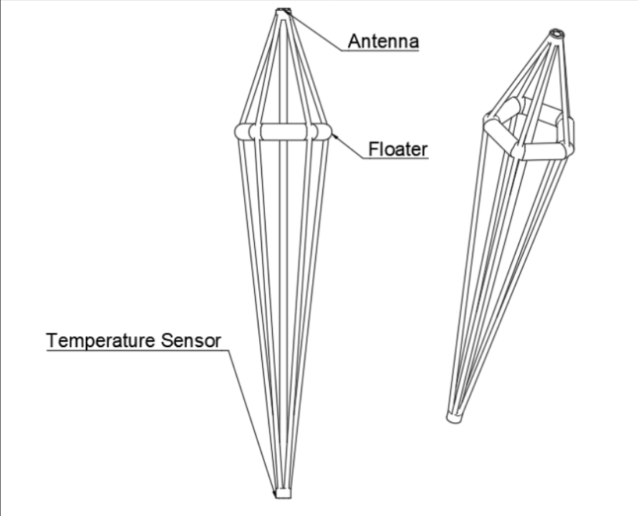
Drifter Architecture

Slide 18
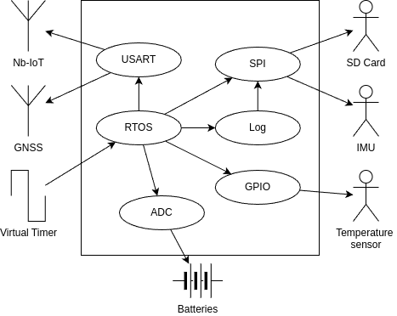
Peripheral Architecture

Slide 19
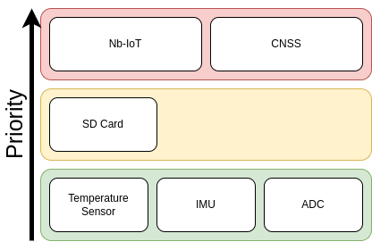
System Architecture

Slide 20
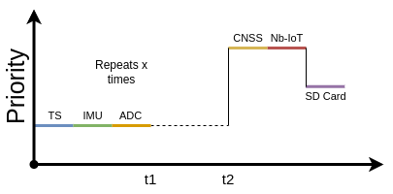
System Architecture

Slide 21
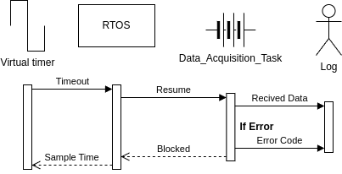
System Architecture

Slide 22
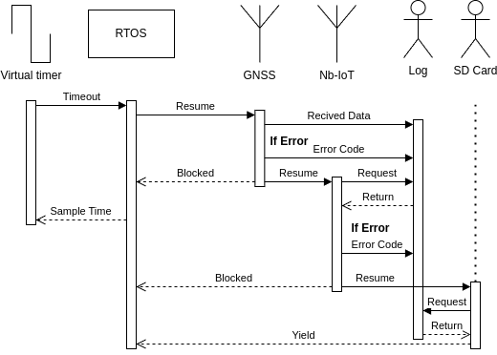
System Architecture

Slide 23
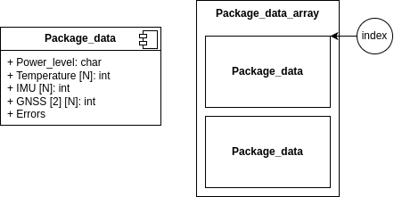
Memory Architecture

Slide 24
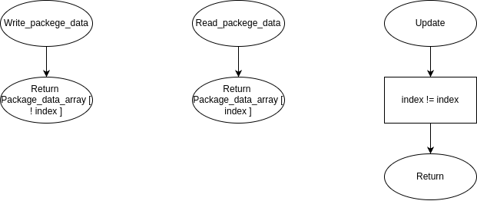
Memory Architecture

Slide 25
Design
Microcontroller: STM32
GNSS and Nb-IoT: ST87M01 evaluation kIT
Sensors
IMU: ISM330BX
Temperature: DS18B20
Batteries
Solar energy
Controller: AEM10941
Panel: SM111K06L
Batteries:

Slide 26
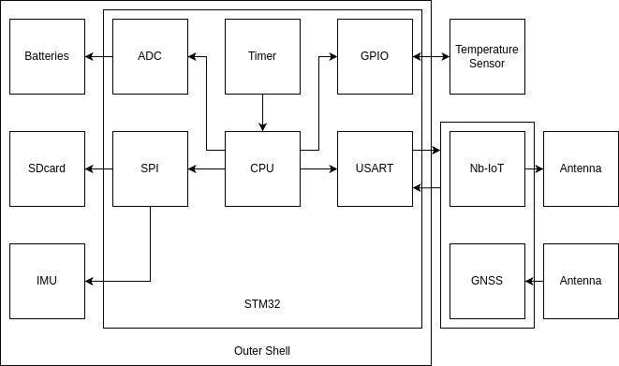
Design

Slide 27
Implementation

Slide 28
Thanks :D
Any questions?

